Slide 1

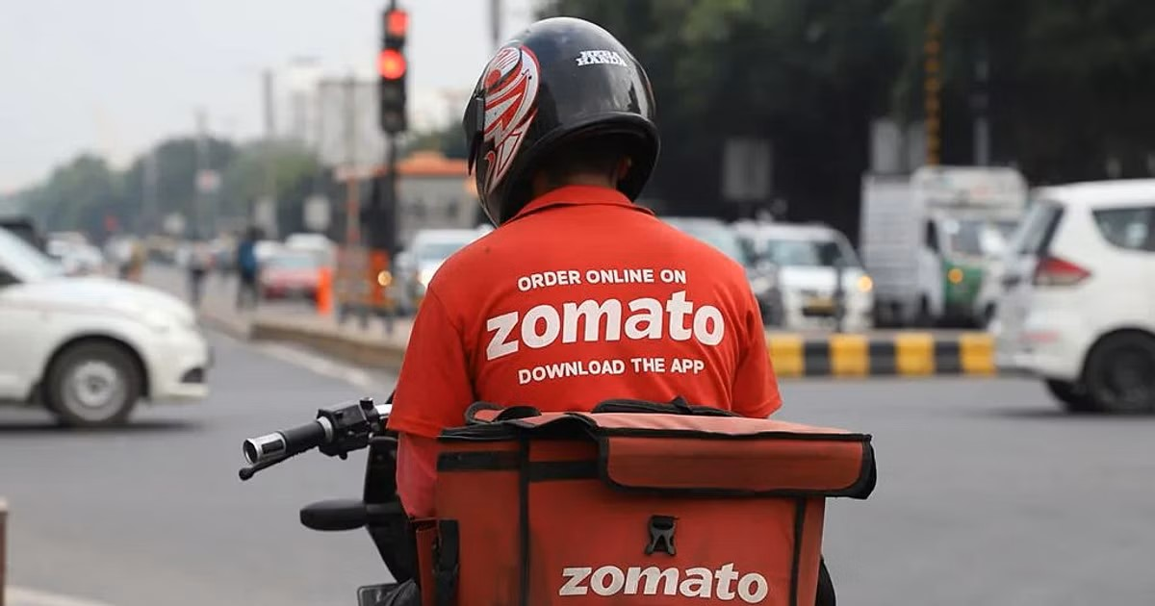
Zomato Analytics Presentation

Slide 2
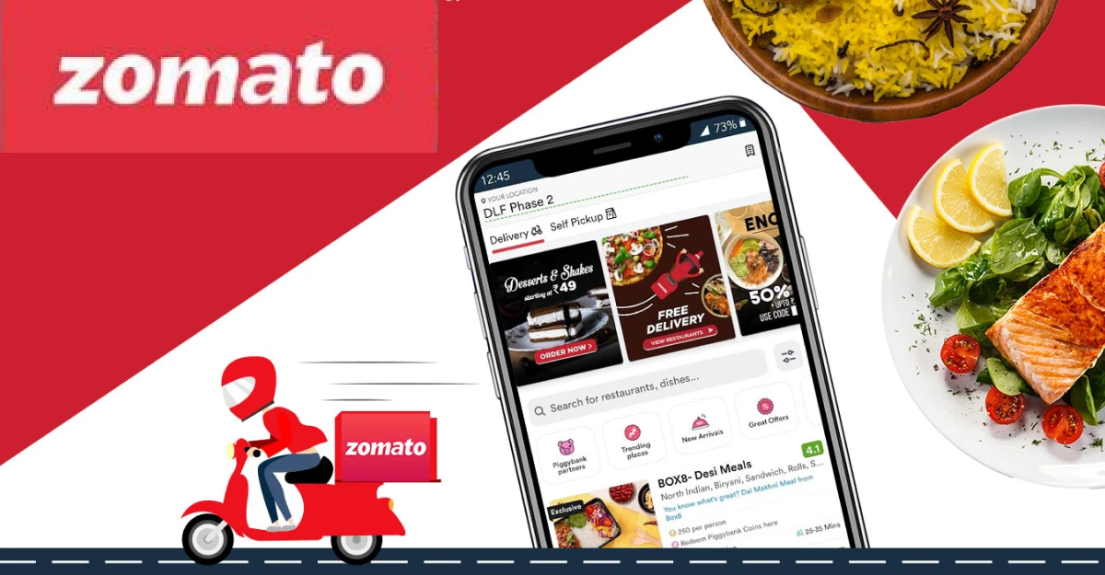
Contents
1.Team
2.Introduction
3.Company Overview
4.Goals

Slide 3
Team 2
Priyanka More
Shraddha Gangurade
Gaurav Kulam
Diksha Angre
Ashwajith Gaur
Priya Nikam
Rajneesh Gaur

Slide 4
Company Overview
Company Profile
Name: Zomato Limited
Founded: 2008
Founders: Deepinder Goyal & Pankaj Chaddah.
Headquarters: Gurugram, Haryana, India.
Industry: Food Delivery, Restaurant Aggregation, Online Ordering.

Slide 5
Zomato
Zomato is a global food delivery and restaurant discovery platform that connects users with local restaurants, cafes, and food outlets. Founded in 2008 by Deepinder Goyal and Pankaj Chaddah in India, Zomato started as a restaurant review and listing service before expanding into food delivery, dining out services, and cloud kitchen partnerships

Slide 6
Goals
Leverage data-driven insights to optimize ratings, customer behavior and price.
Analyze price patterns to identify growth opportunities.
Understand customer preferences for better decision-making.
Deliver actionable insights to guide strategic business decisions.

